Slide 1
Method for the separation of PIPS, inverted PIPS, partial engulfment, and homogeneous LLPS
Summary: PIPS, inverted PIPS, and partial engulfment were successfully separated, and I found that the separation of homogeneous LLPS from the others depended on the definition.

Slide 2
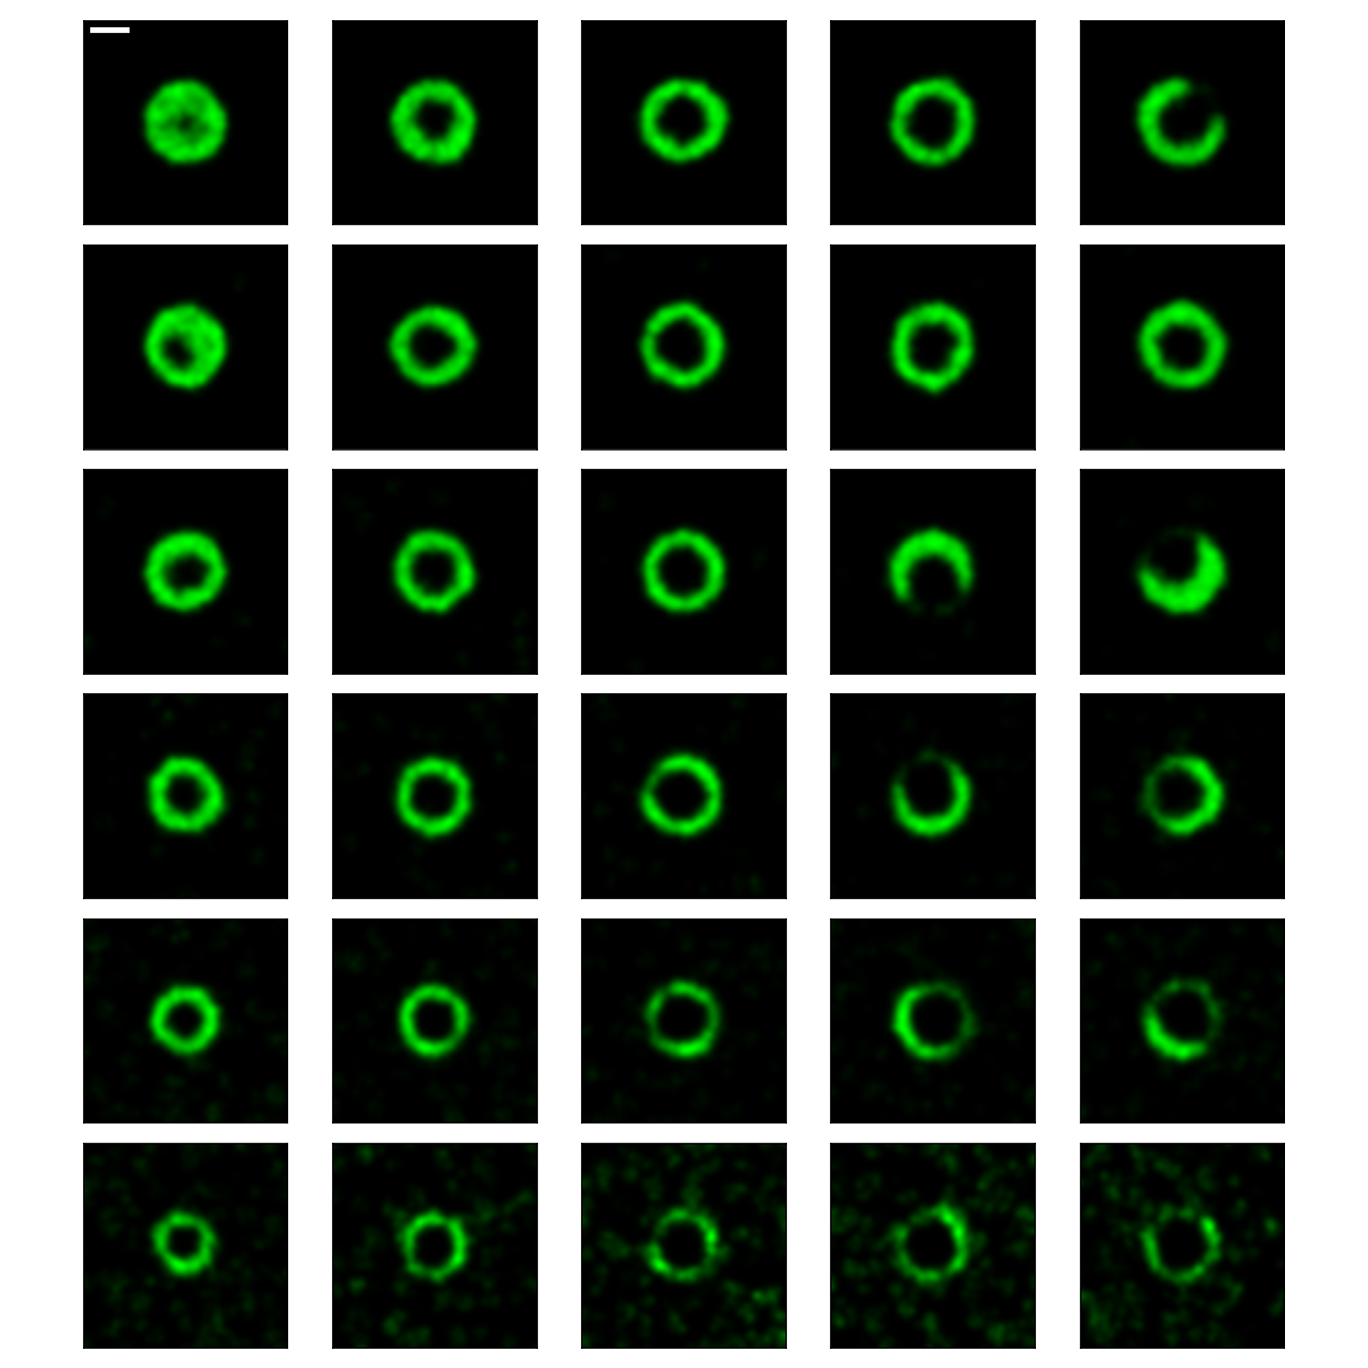
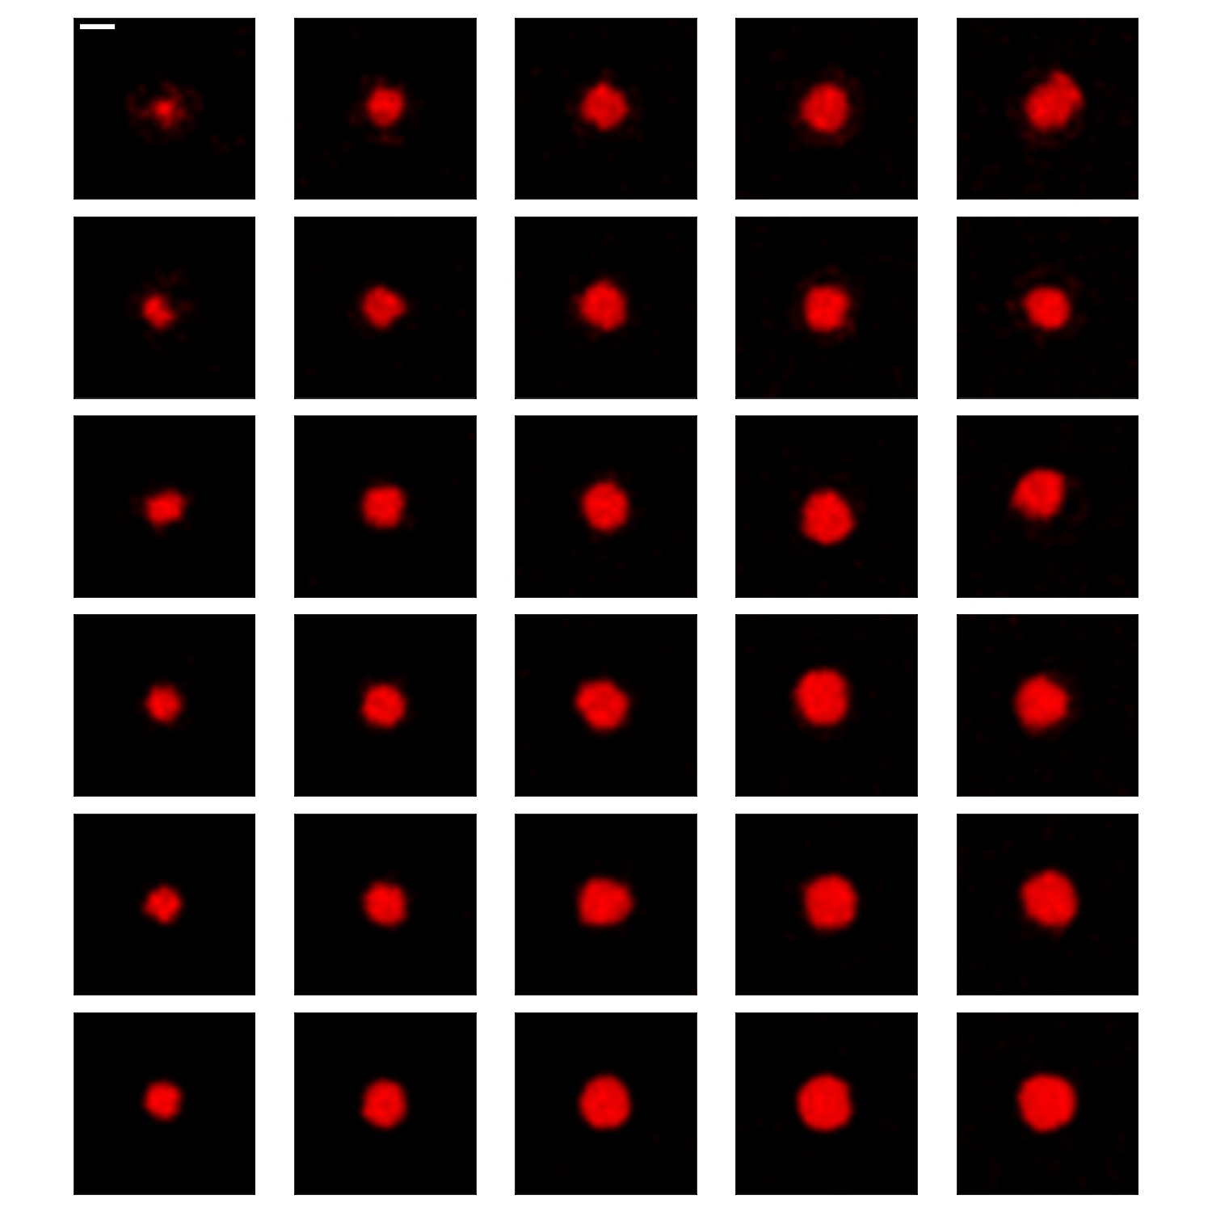
matrix/matrix_profile_CaMKII_sigma_2.png matrix/matrix_profile_STG_sigma_2.png
Target to obtain the phase diagram
that separates PIPS, Homogenous LLPS, and partial engulfment
Locations of CaMKII and STG were smoothed by a Gaussian filter (sigma = 2 l.u.).
STG (number)
STG (number)
500 1000 2000 3000 4000
500 1000 2000 3000 4000
12000
8000
6000
4000
2000
500
12000
8000
6000
4000
2000
500
GluN2B (number)
GluN2B (number)

Slide 3
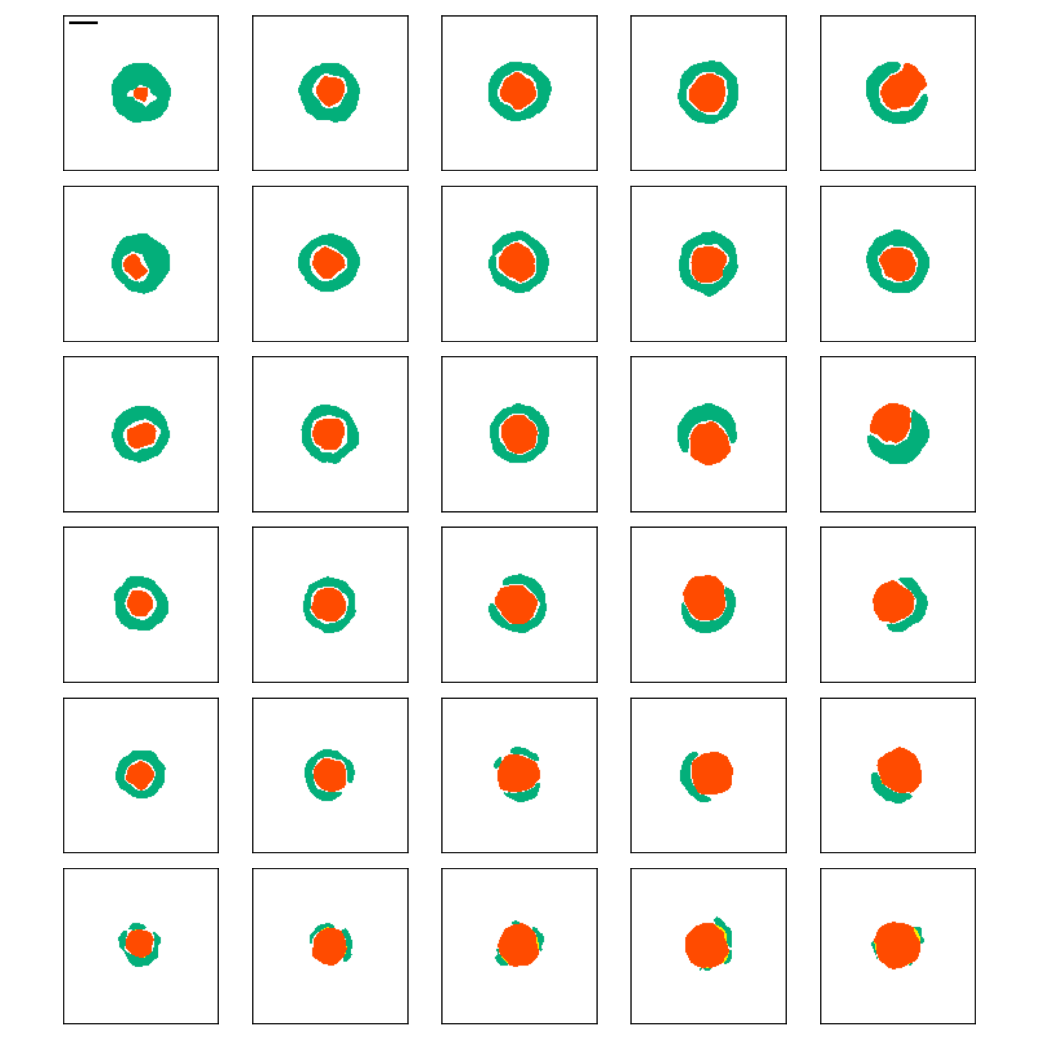
matrix/matrix_region_condensates_sigma_2.png
STG (number)
[CaMKII]_{max}
500 1000 2000 3000 4000
0.5 x ([CaMKII]_{max} + [CaMKII]_{min} )
[CaMKII]_{min}
12000
8000
6000
4000
2000
500
We obtained the regions of each species over half-maximal concentration from the baseline. They were defined as condensates.
Green: CaMKII condensates
Red: STG condensates
GluN2B (number)
The PIPS and partial engulfment was not easy to separate using the 2D sections of their condensates (right), because the partial engulfment occurs in the 3d space.

Slide 4
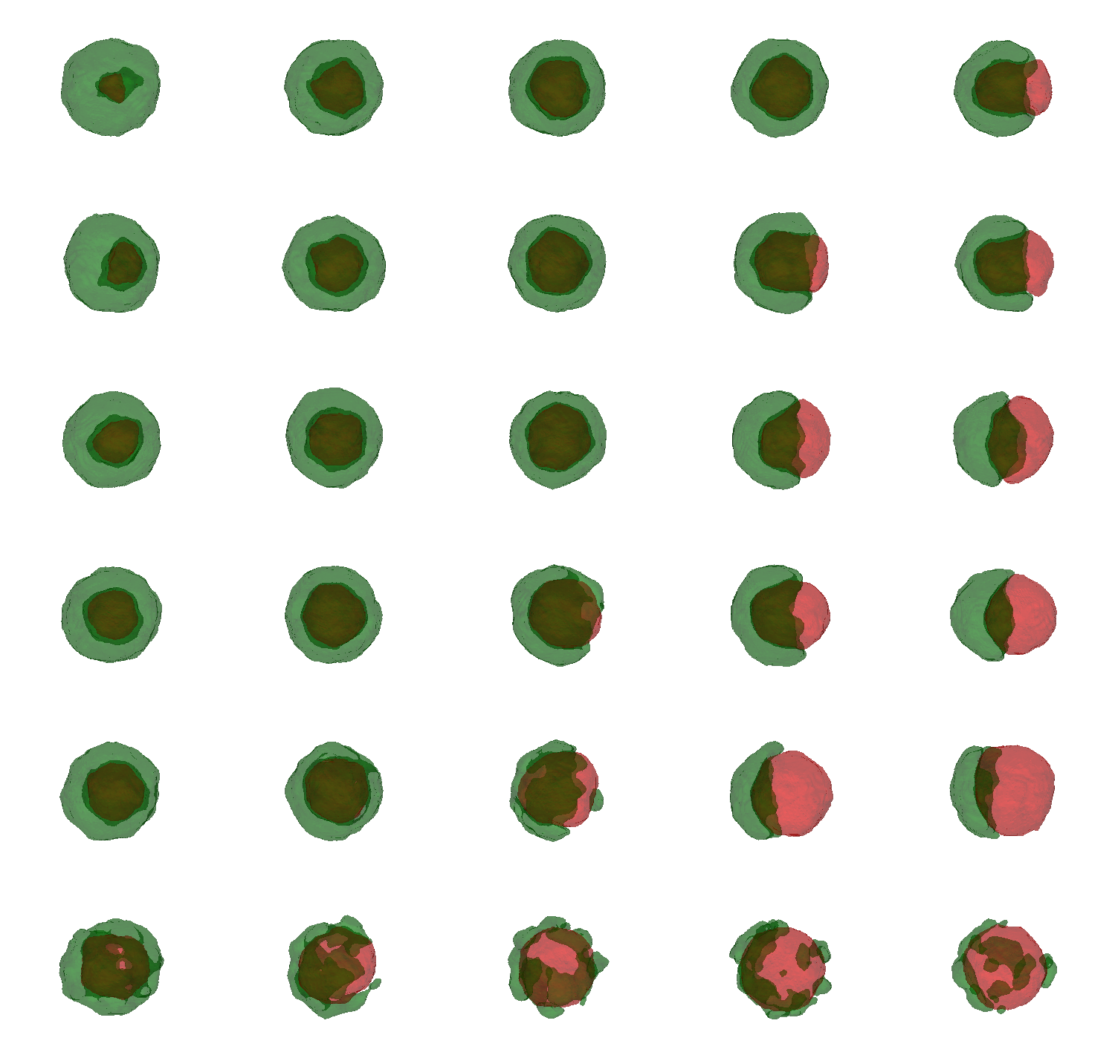
region_condensates_pyvista/summary_sigma_2.png
STG (number)
500 1000 2000 3000 4000
Thus, the condensates in the 3d space were plotted after the alignments of the separation direction.
This was useful for presentation and visual inspection; however, the categorization based on the condensates was still inaccurate, because STG was covered even by the lower concentration of CaMKII.
12000
8000
6000
4000
2000
500
GluN2B (number)

Slide 5
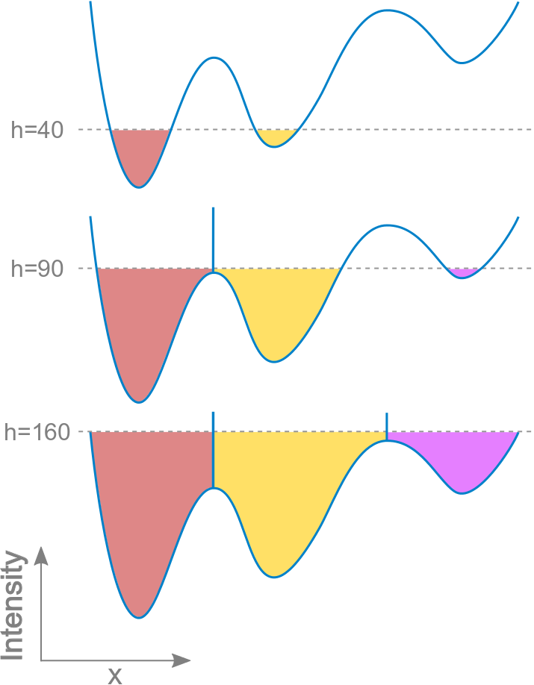
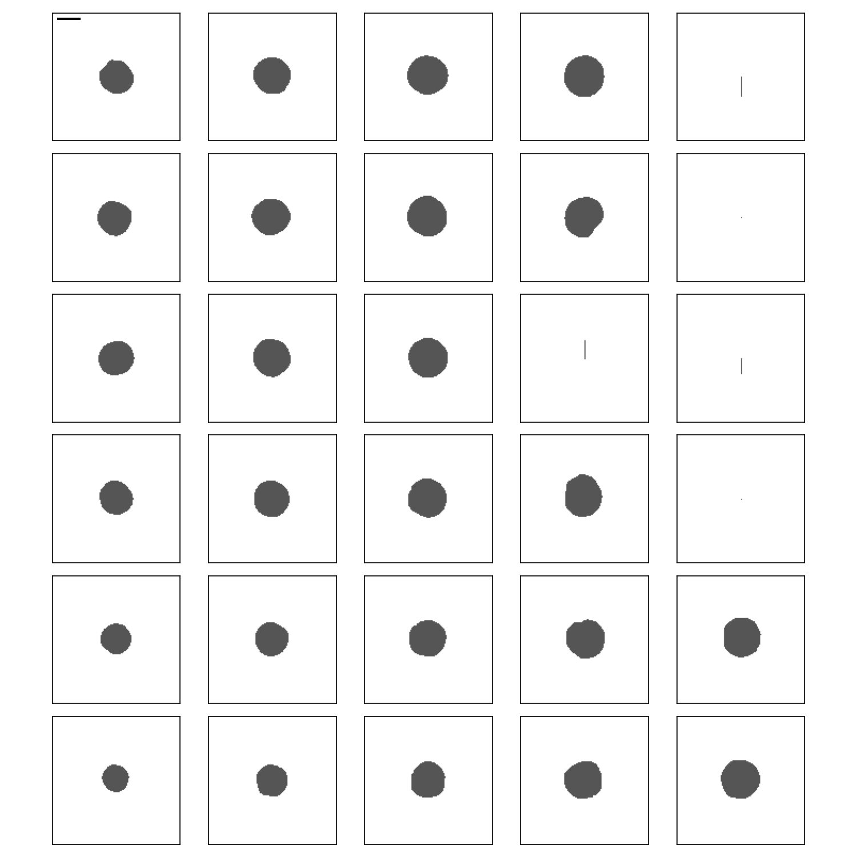
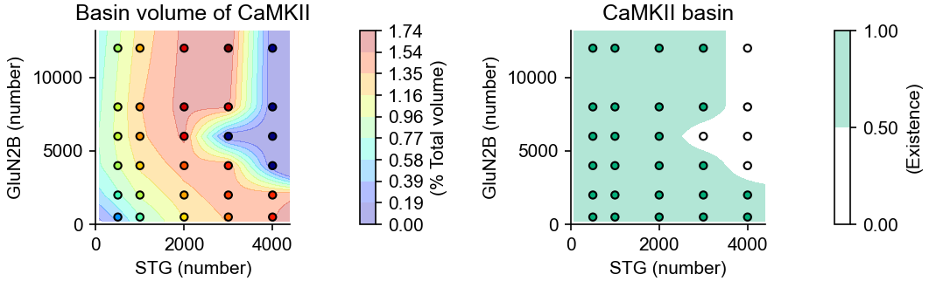
matrix/matrix_watershed _CaMKII _sigma_4.png phase_diagram/volume_watershed_sigma_4.png
We utilized the watershed algorithm, which is commonly used to separate adjacent drainage basins.
STG (number)
500 1000 2000 3000 4000
https://imagej.net/plugins/classic-watershed
12000
8000
6000
4000
2000
500
If the watershed algorithm applied to spatially-smoothed CaMKII (Gaussian filter, sigma = 4 l.u.), PIPS was successfully separated from the partial engulfment.
However, it cannot separate the homogeneous LLPS, because the watershed does not detect the partition index.
GluN2B (number)

Slide 6
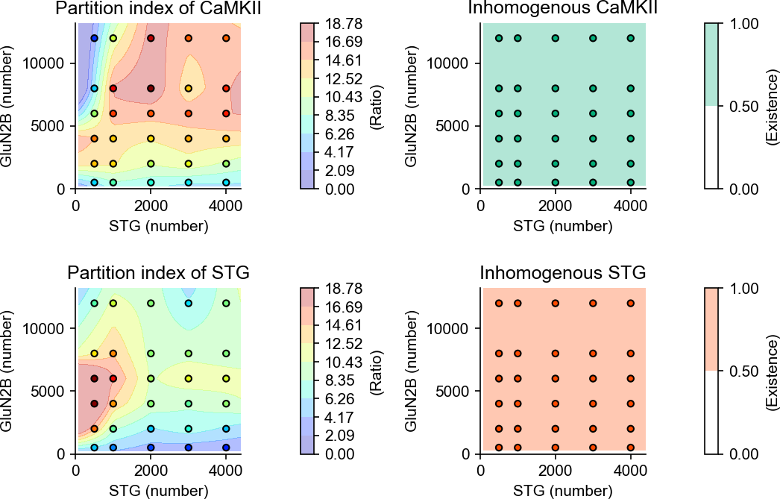
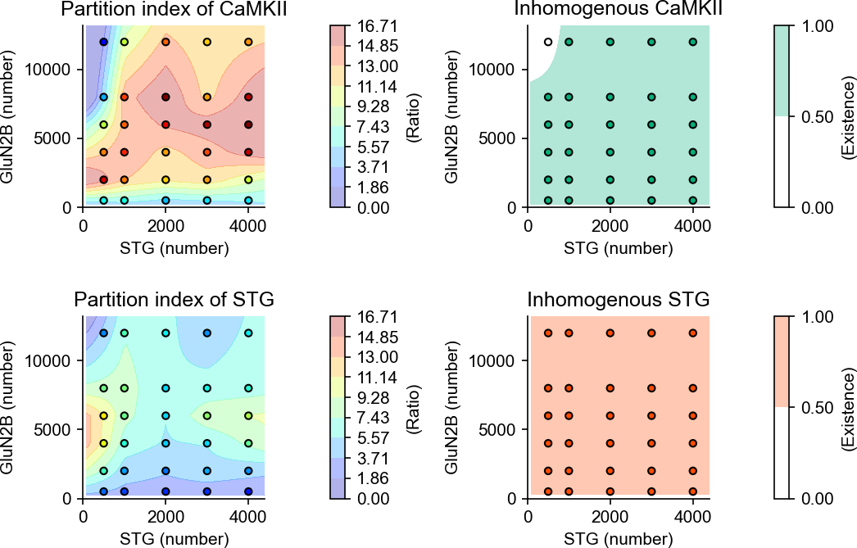

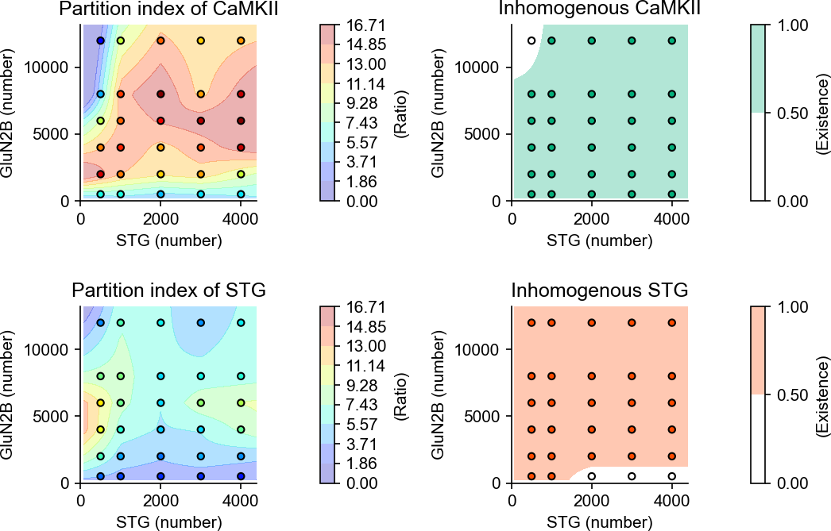
phase_diagram/partition_index_sigma_2_th_2.png phase_diagram/partition_index_sigma_2_th_3.png phase_diagram/partition_index_sigma_4_th_2.png phase_diagram/partition_index_sigma_4_th_3.png
Sigma of Gaussian filter : 2 l.u.
Threshold of partition index for inhomogeneity : 2
Sigma of Gaussian filter : 4 l.u.
Threshold of partition index for inhomogeneity : 2
The partition indices between CaMKII and STG condensates were obtained for the separation of homogeneous LLPS from the others.
1. The smaller number of STG produced homogeneous CaMKII.
2. The smaller number of GluN2B produced homogeneous STG.
Those two depended on the smoothing of the concentration, and on the threshold for inhomogeneity.
How do we determine which one is the homogeneous LLPS?
Sigma of Gaussian filter : 2 l.u.
Threshold of partition index for inhomogeneity : 3
Sigma of Gaussian filter : 4 l.u.
Threshold of partition index for inhomogeneity : 3

Slide 7
Some example profiles ..

Slide 8
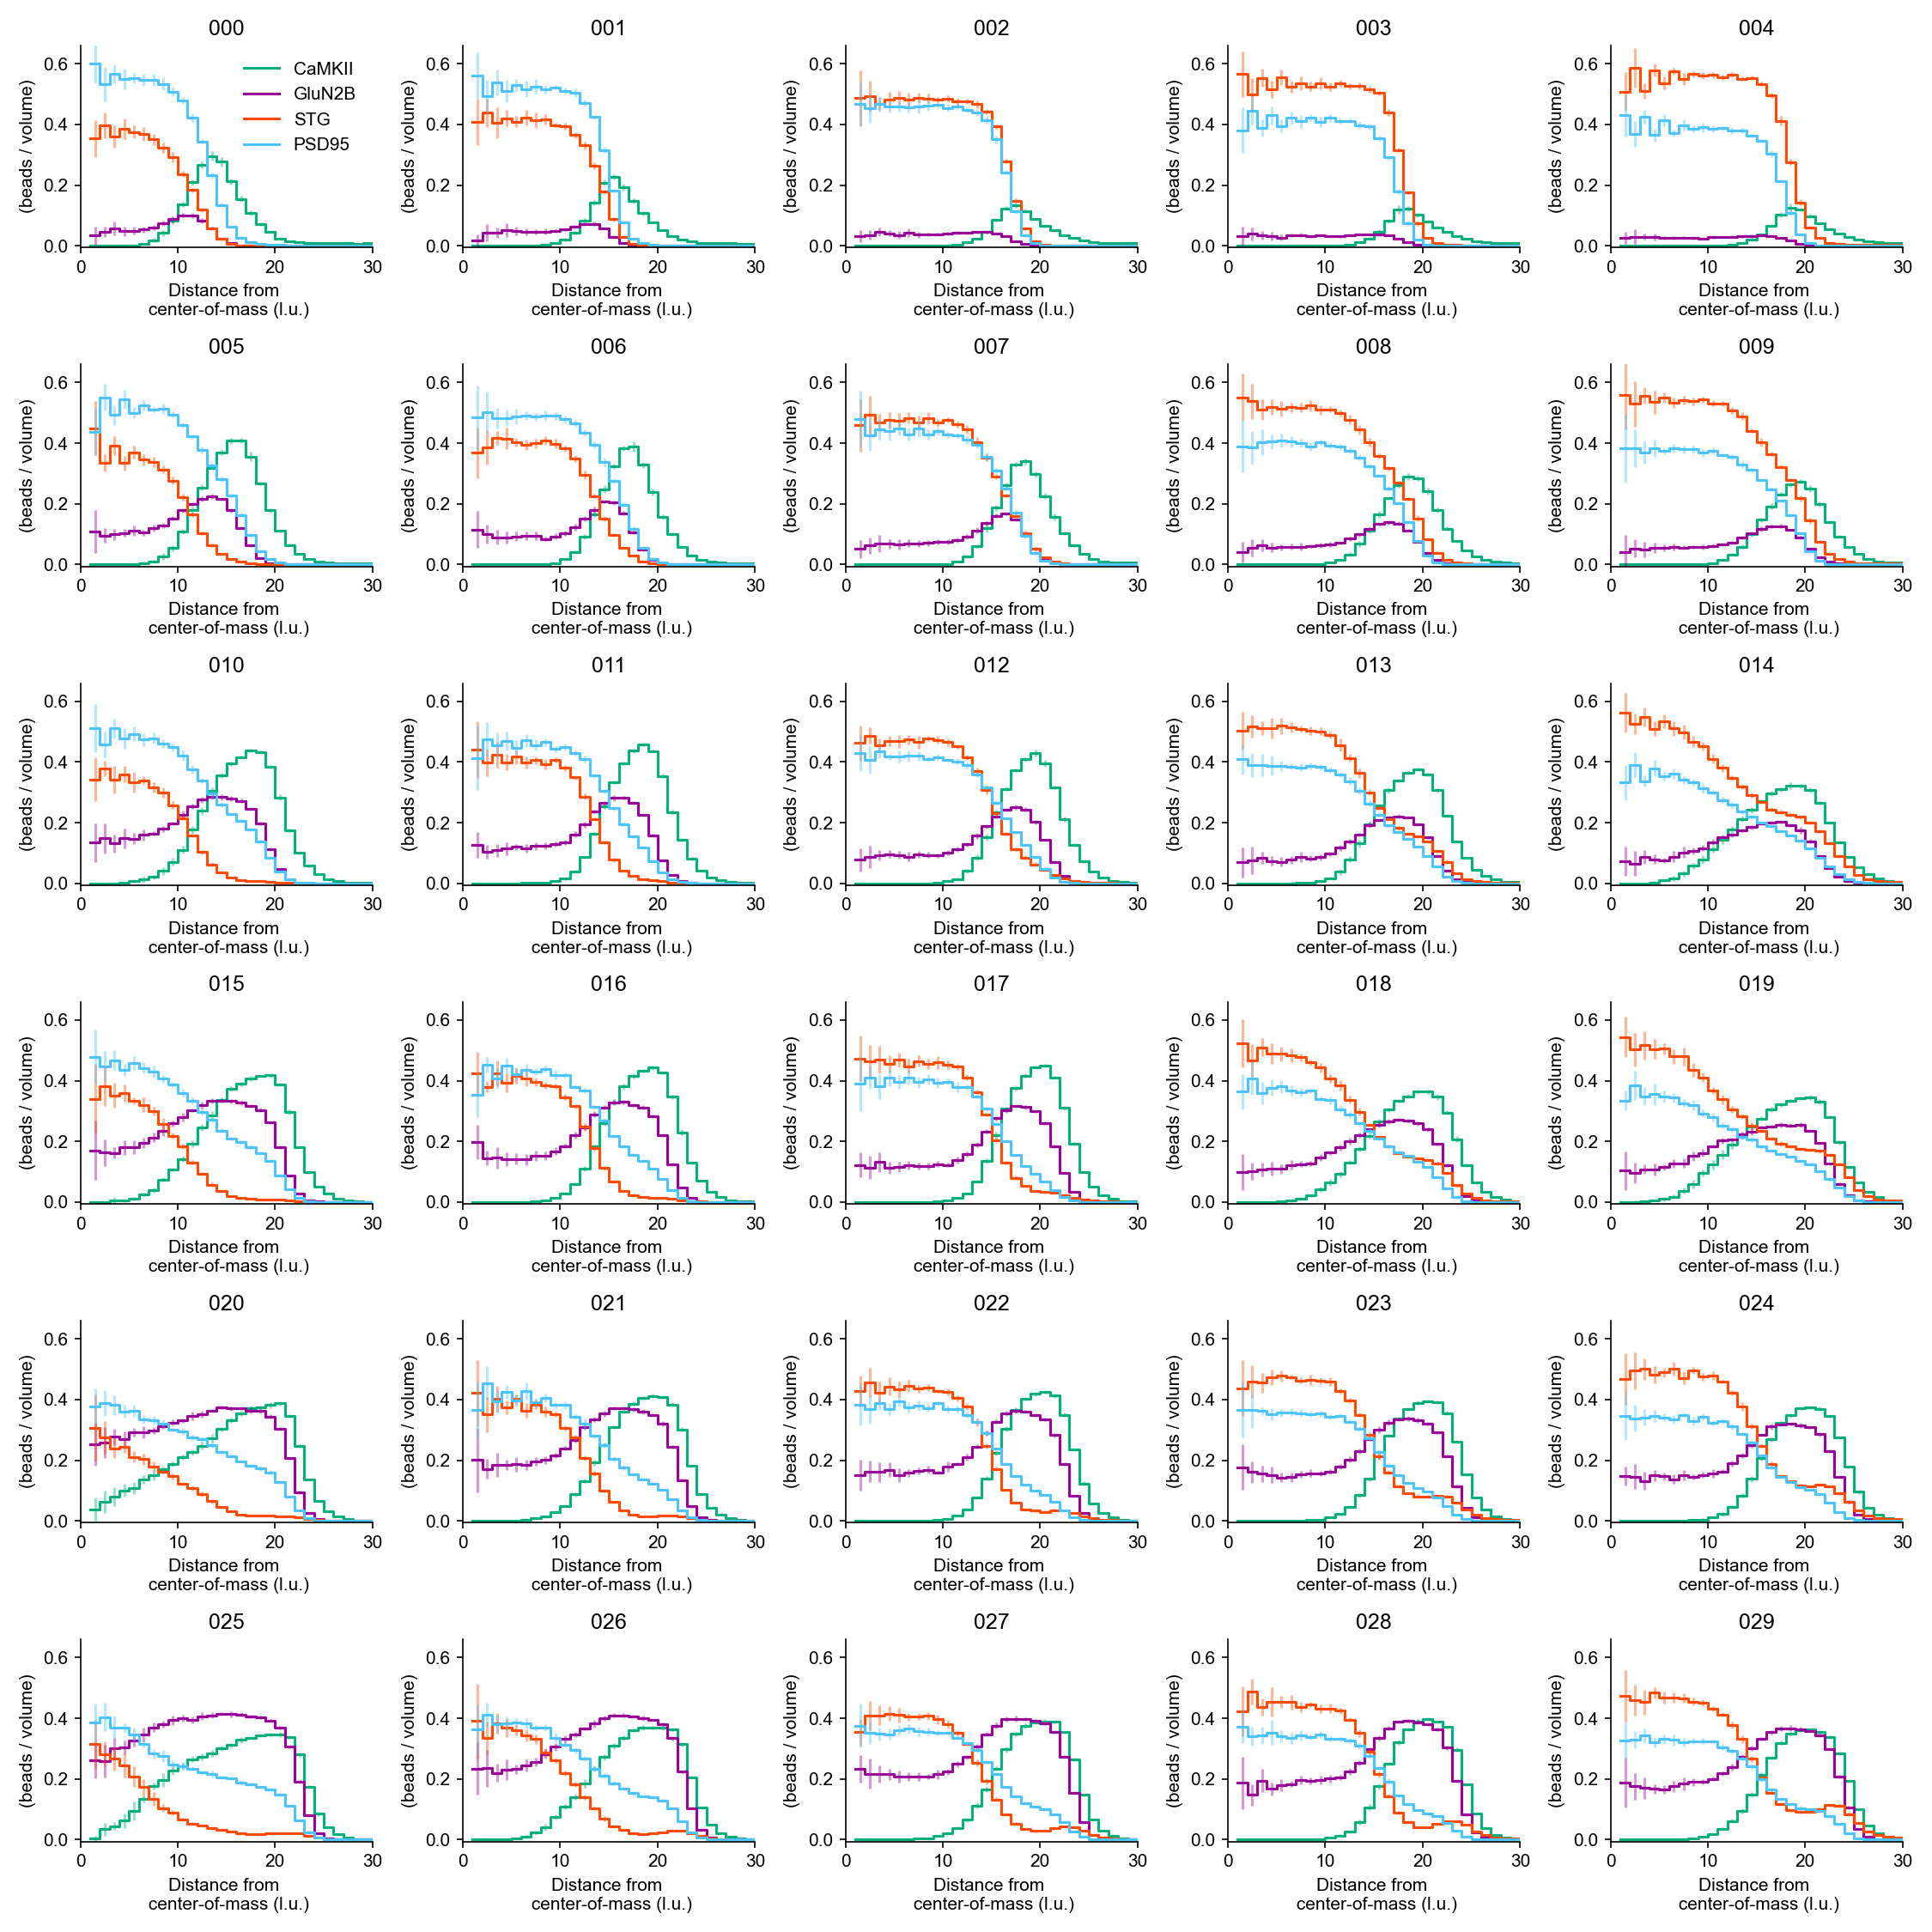
rdf_matrix/rdf_matrix.png
This program was revised
for the color universal design.

Slide 9
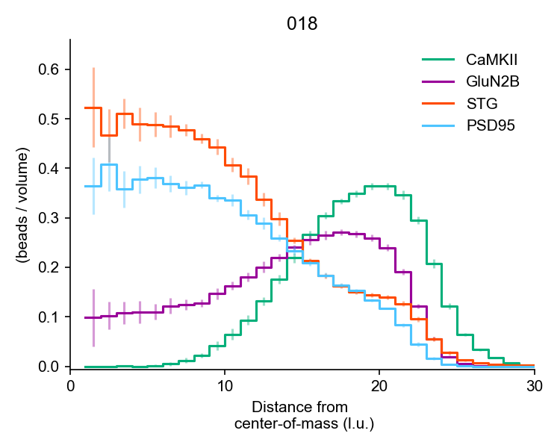
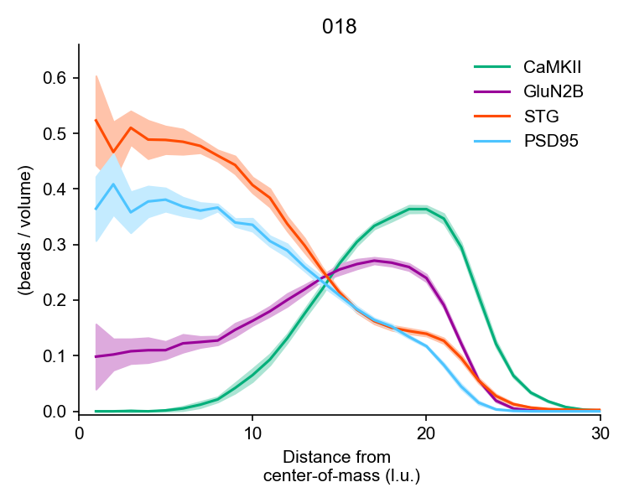
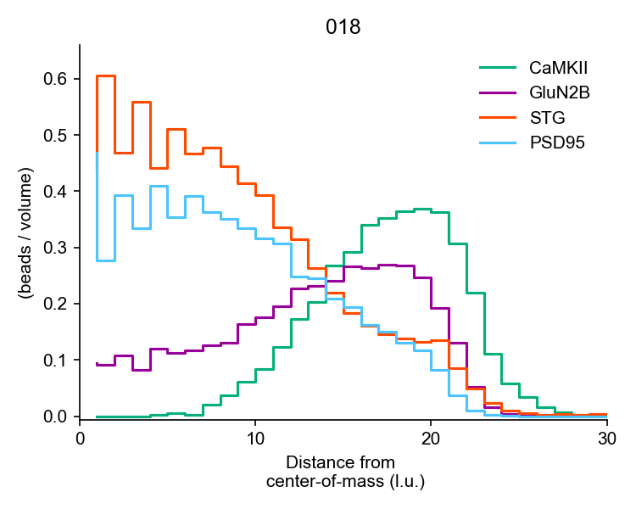
rdf_solo/rdf_R3_018.png
This program was revised
for the color universal design.

Slide 10
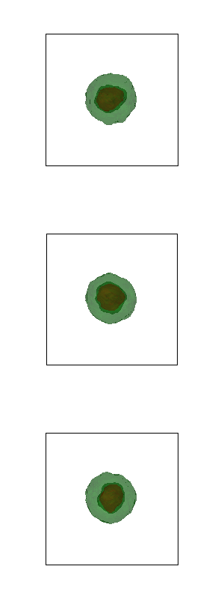
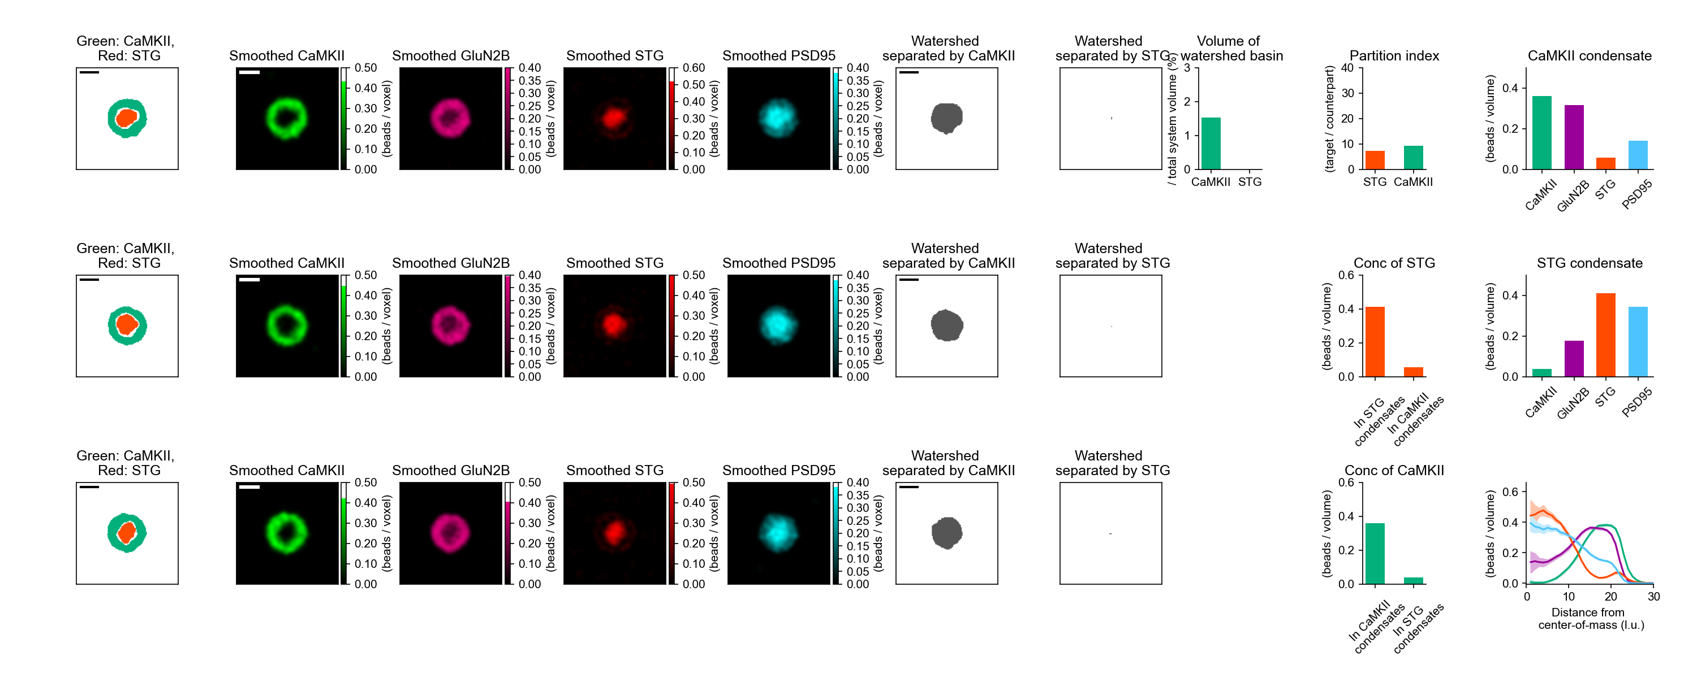
profiles_example/PIPS_sigma_2.png region_condensates_pyvista/PIPS_sigma_2.png

Slide 11
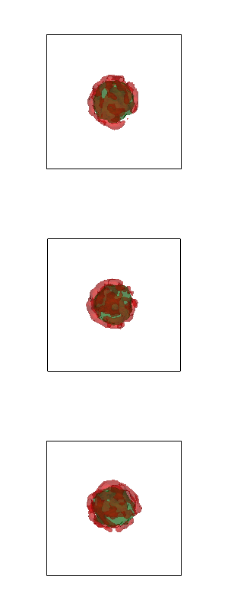
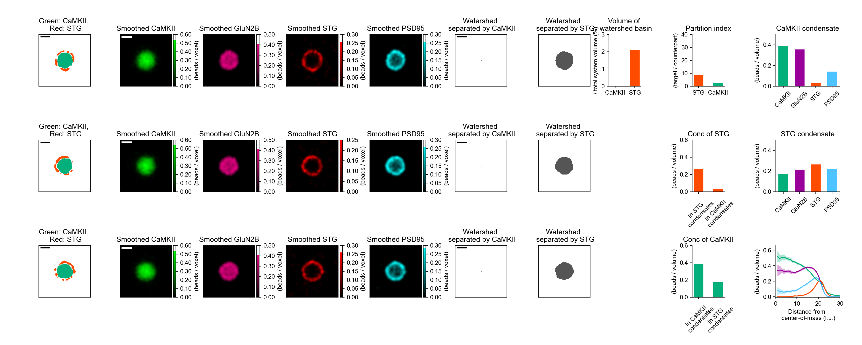
profiles_example/iPIPS_sigma_2.png region_condensates_pyvista/iPIPS_sigma_2.png
Similar to homogeneous LLPS

Slide 12
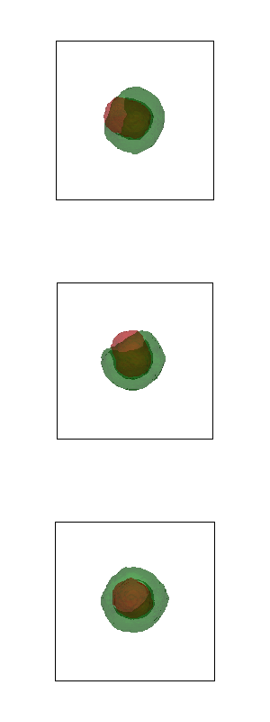
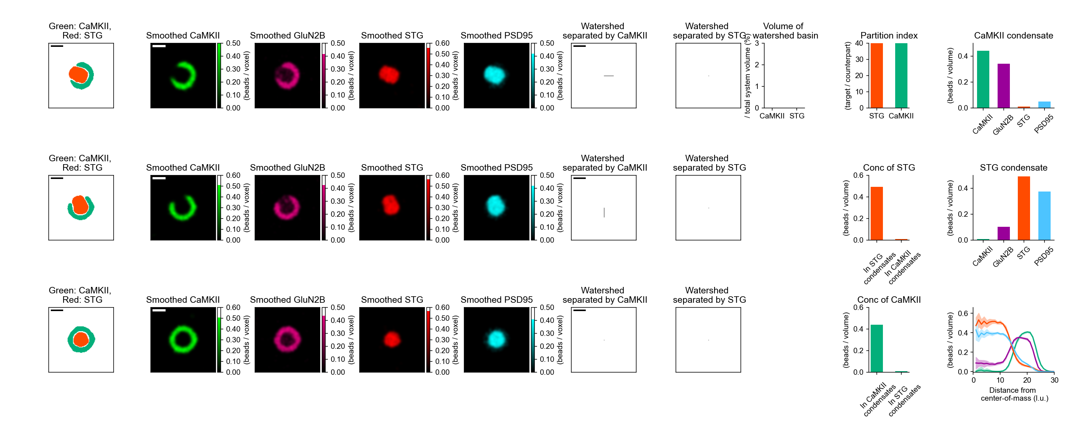
profiles_example/PartialE_sigma_2.png region_condensates_pyvista/PartialE_sigma_2.png
Large over ylim

Slide 13
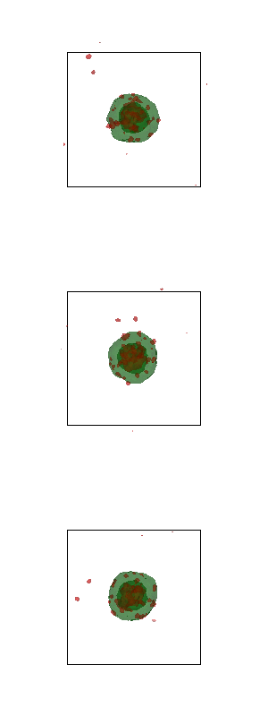
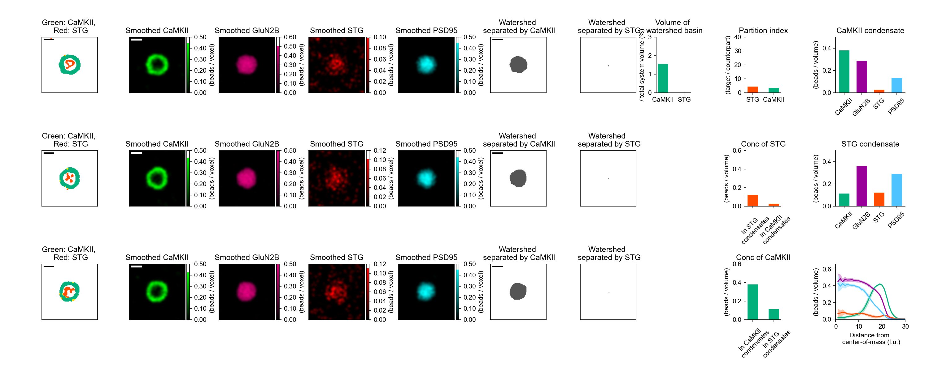
profiles_example/Homo_sigma_2.png region_condensates_pyvista/Homo_sigma_2.png
Small, but similar to iPIPS

Slide 14
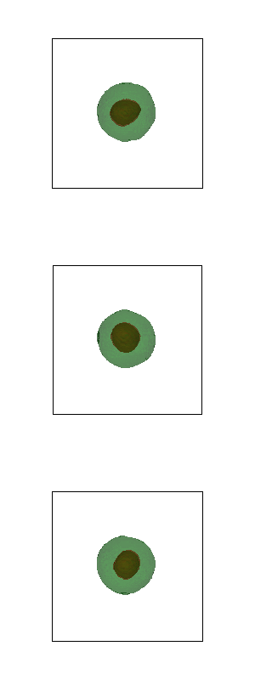
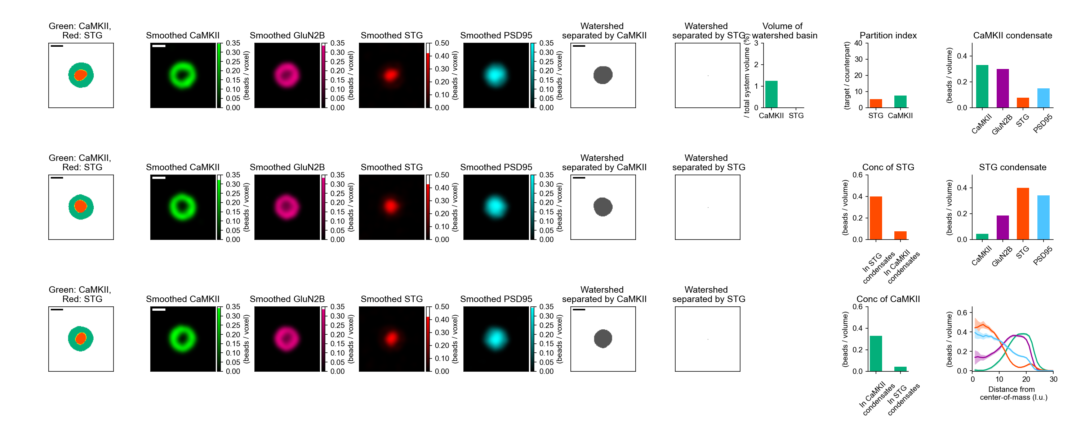
profiles_example/PIPS_sigma_4.png region_condensates_pyvista/PIPS_sigma_4.png

Slide 15
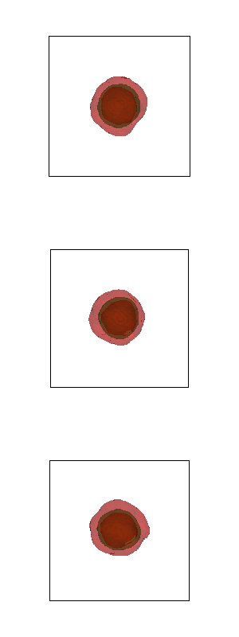
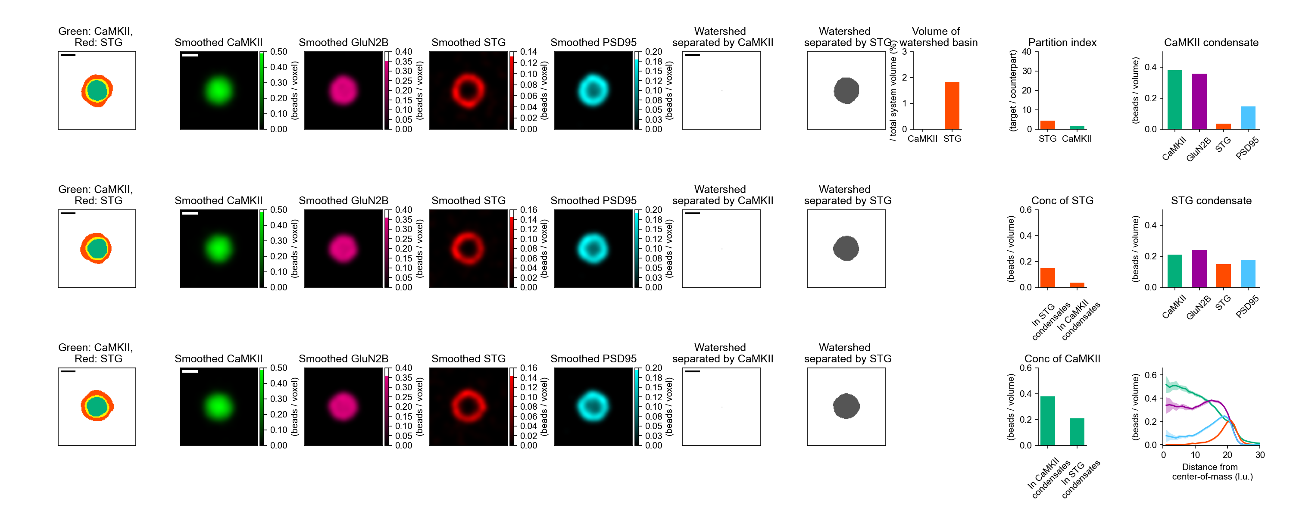
profiles_example/iPIPS_sigma_4.png region_condensates_pyvista/iPIPS_sigma_4.png
Similar to homogeneous LLPS

Slide 16
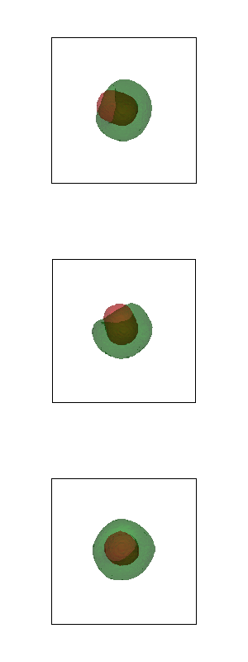
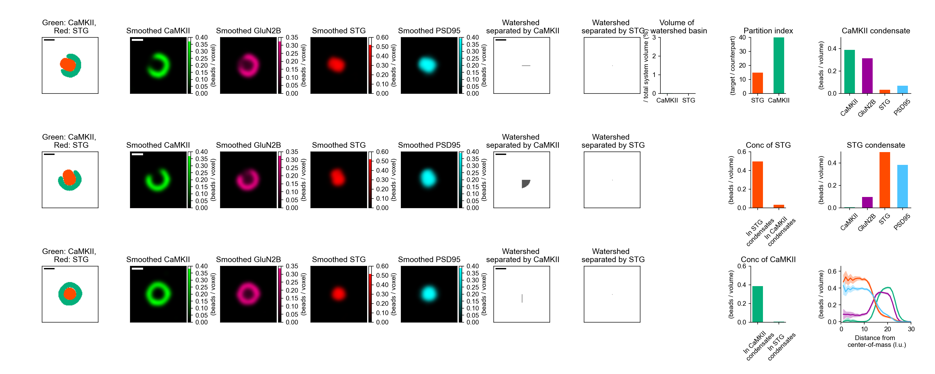
profiles_example/PartialE_sigma_4.png region_condensates_pyvista/PartialE_sigma_4.png

Slide 17
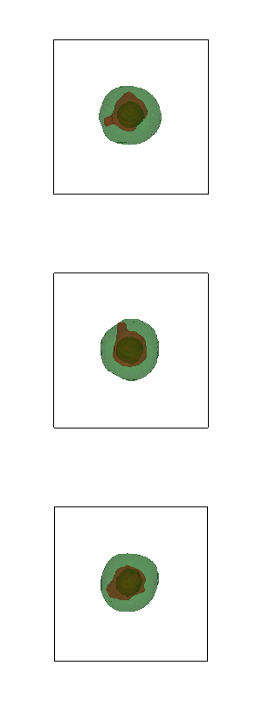

profiles_example/Homo_sigma_4.png region_condensates_pyvista/Homo_sigma_4.png
Small, but similar to iPIPS

